Slide 1
Large Language Models for Generative AI
AIML* ZG536
Dr. Monali Mavani

Slide 2

Large Language Models for Generative AI
Disclaimer and Acknowledgement
The content for these slides has been obtained from books and various other source on the Internet
I here by acknowledge all the contributors for their material and inputs.
I have provided source information wherever necessary
I have added and modified the content to suit the requirements of the course

Slide 3
Agenda
Normalization: LayerNorm, RMSNorm, QKNorm, Norm placement
Positional Encoding Advances : RoPE, NoPE
Advanced activations : GELU, Swish, Gated Linear Units (GLU)
MoE

Slide 4
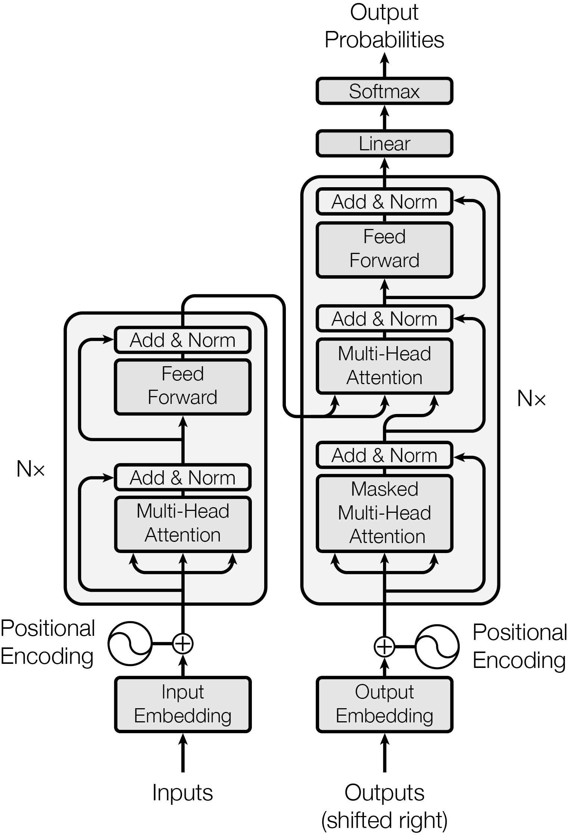
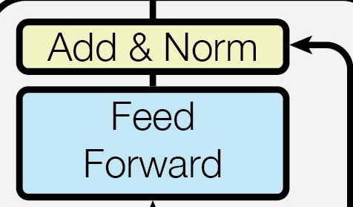
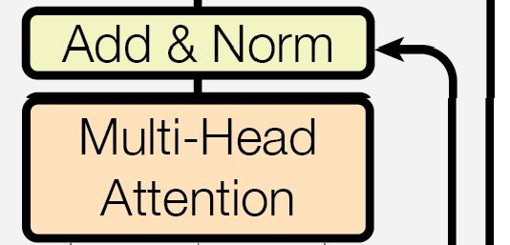
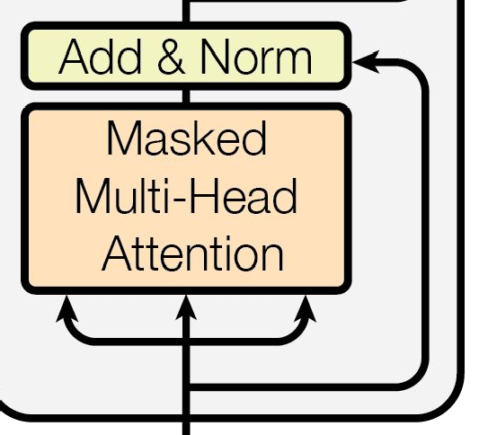
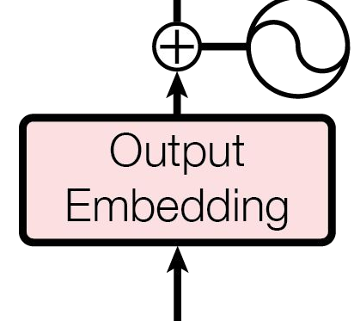
Transformer architecture
Feed Forward
Attention Layer Norm
Places for Improvements
Positional Encoding

Slide 5



RMSNorm
RMSNorm is simplified version of LayerNorm with fewer trainable parameters
LayerNorm enforces zero mean and unit variance. RMSNorm only rescales by the root-mean-square (RMS) of the activations, so it controls the magnitude of the activations but does not force them to be centered around zero.
RMSNorm does not compute both a mean and a variance
~7–15% faster than LayerNorm due to fewer operations (no mean computation)
It largely displaced LayerNorm in current decoder stacks because it solves the same optimization problem with a slightly cheaper computation
a = raw summed inputs
g = gain parameter used to re-scale the standardized summed inputs

Slide 6
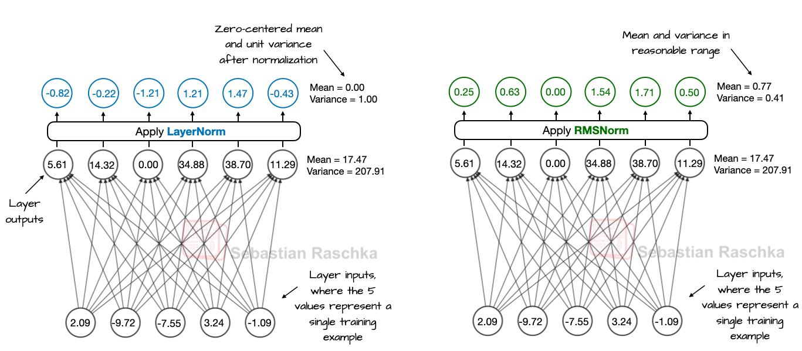
LayerNorm Vs RMSNorm
https://sebastianraschka.com/llms-from-scratch/ch04/09_rmsnorm/

Slide 7
Pre-Norm vs Post Norm
In Post-Norm (original "Attention is All You Need" design), LayerNorm is applied after the sublayer (attention and FFNN) and residual addition
  PostNorm(x) = LayerNorm(x + Sublayer(x))
Pre-Norm applies LayerNorm before the sublayer, keeping the residual addition outside
PreNorm(x) = x + Sublayer(LayerNorm(x))
  Gradient highway: Gradient has a direct, unmodified path back through the residual connection, bypassing both the sublayer and normalization entirely
  Trains stably even at 100+ layers without warmup tricks
  Tolerates larger learning rates and doesn’t require careful learning rate warm-up
OLMo 2 moves RMSNorm into a post-norm-like position inside the residual path, while Gemma 3 uses it both before and after sublayers

Slide 8
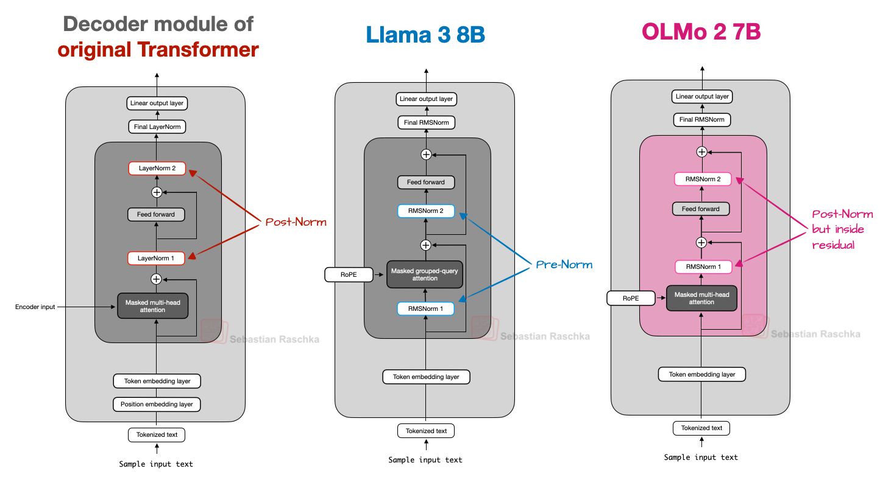

Slide 9


QK-Norm
Applies l2 normalization to Q and K only, and it does so along the head dimension(which is the same dimension as the embedding dimension, but after multihead attention has split its input into separate heads)
It stabilizes attention computation by forcing query and key vectors onto a controlled scale instead of letting large norms dominate the dot product
It reduces softmax saturation, so gradients remain more useful during training
Improves gradient stability, reduces training instability
MiniMax M2 used a per-head variation
Qwen3-Next moved toward a zero-centered variant inside its gated attention blocks
g is learnable scalar parameter

Slide 10
Position Embedding

Slide 11
Rotary Positional Embeddings (RoPE)
Key intuition: instead of each token saying “I am at position k”, pairs of tokens should implicitly say “we are k tokens apart”
Example: “my daughter called her brother last night”
“last night, my daughter called her brother”
Attention between “daughter” and “called” should be invariant to shifts.
Linguistic motivation: many dependencies (e.g., adjective–noun, pronoun–antecedent, verb–subject) are inherently relative, not tied to fixed absolute positions.
Rotation captures relative distance

Slide 12
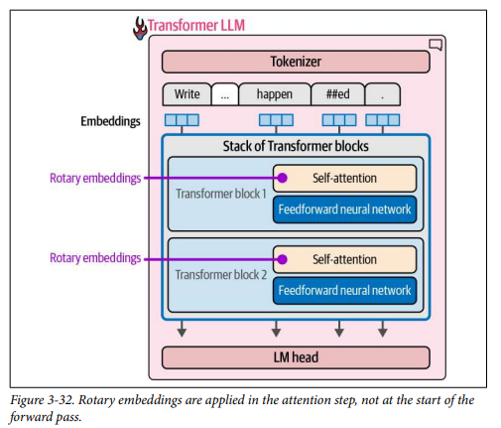
RoPE
Introduced in the RoFormer paper (Su et al., 2021)
RoPE rotates the query and key vectors using position-dependent sine and cosine terms.
The practical effect is that relative position gets encoded directly into the dot product used by attention
So instead of adding a separate learned vector for “position 512,” the attention computation itself becomes position-aware.

Slide 13
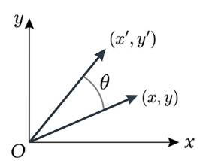

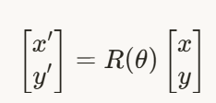





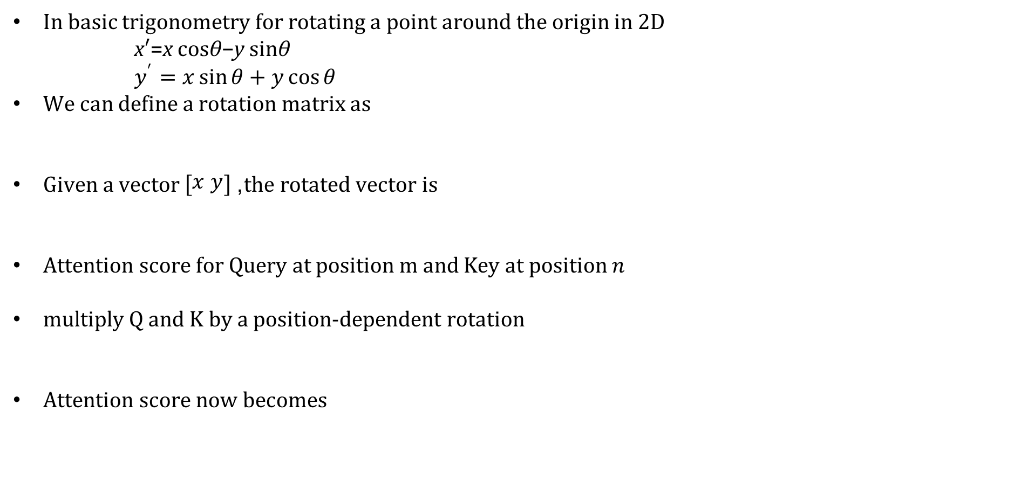
RoPE
In basic trigonometry for rotating a point around the origin in 2D
      x′=x cosθ−y sinθ
      $$y^{′}=x\sin{θ}+y\cos{θ}$$
We can define a rotation matrix as
Given a vector $\left[\begin{matrix}x y\end{matrix}\right]$, the rotated vector is
Attention score for Query at position m and Key at position $n$
multiply Q and K by a position‑dependent rotation
Attention score now becomes
By the algebra of rotations →

Slide 14
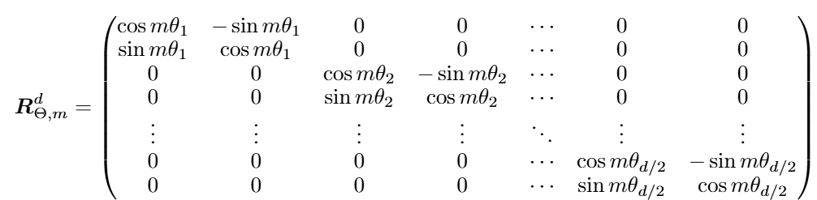
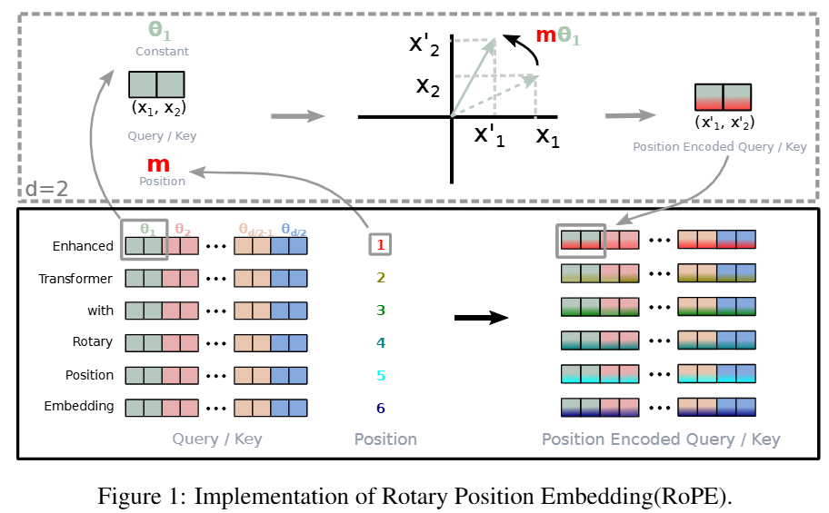

RoPE
Splitting each vector into $d/2$ , 2D pairs: $\left(x_{0} , x_{1}\right),\left(x_{2} , x_{3}\right),…$.
Applying a different rotation angle to each pair
θ_{i} = 10000^{−2(i−1)/d} in radians
i ∈ [1, 2, ..., d/2]

Slide 15
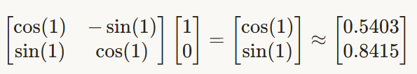

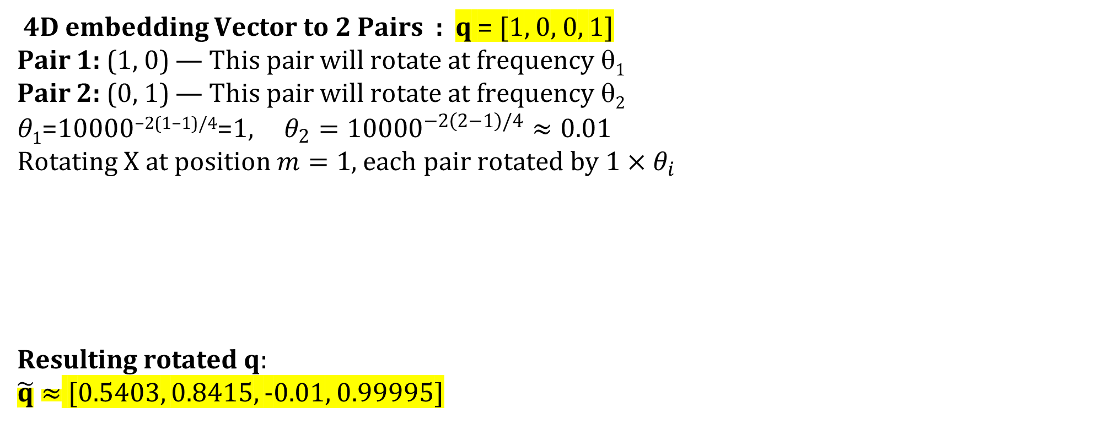


Rotation example for RoPE
4D embedding Vector to 2 Pairs : q = [1, 0, 0, 1]
Pair 1: (1, 0) — This pair will rotate at frequency θ₁
Pair 2: (0, 1) — This pair will rotate at frequency θ₂
θ₁​=10000^{−2(1−1)/4}=1, $θ_{2}={10000}^{−2\left(2−1\right)/4}≈0.01$
Rotating X at position $m=1$, each pair rotated by $1×θ_{i}$
Resulting rotated q:
$\tilde{q}≈$ [0.5403, 0.8415, -0.01, 0.99995]
θ_{i} = 10000^{−2(i−1)/d}
i ∈ [1, 2, ..., d/2]
Pair 1 $\left(1×θ_{1}=1\right)$
Pair 2 $\left(1×θ_{2}=0.01\right)$

Slide 16
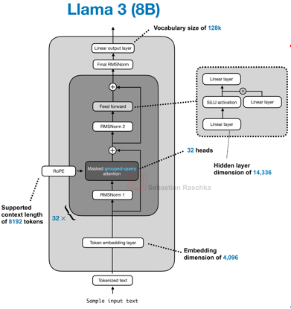
RoPE
Why did many models move away from learned absolute positional embeddings?
  Better handling of relative distances. RoPE makes the attention interaction itself position-aware
  Better long-context behavior. It is often easier to extend or adapt RoPE-based models to larger context windows
  Cleaner integration with attention. Position is encoded where it matters most: in the query-key interaction
Typical models: Llama, Qwen, GPT-OSS, DeepSeek, GLM-4.5, Sarvam 30B

Slide 17
No Positional Embeddings (NoPE)
Omitting explicit positional information injection in selected attention layers
The key point is that causal generation still imposes an ordering structure. A token can attend only to earlier tokens, not future ones
Intuition: if position is not hard‑wired, the model may learn relative, content‑driven patterns that extrapolate more smoothly when the sequence is longer than anything seen in training
Practical use is hybrid architectures now mix:
  RoPE layers (strong recency/positional bias)
  NoPE layers (long‑range, content‑only retrieval)
E.g. SmolLM3 omits it in every fourth layer

Slide 18
Advanced activations
GELU, Gated Linear Units (GLU), SwiGLU

Slide 19
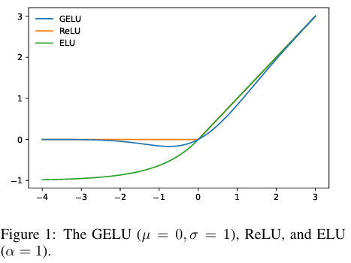


GELU (Gaussian Error Linear Unit)
Introduced in 2016 and popularized by BERT and GPT-2/3, Google's Gemma models
Goal: keep the good properties of ReLU (no saturation for large positives) but make the activation smooth and probabilistic instead of a hard on/off gate.
ϕ(x)= standard Gaussian CDF, number in [0,1], so GELU smoothly weights each input instead of hard‑clipping it
Smooth gradients everywhere
No “dying ReLU”
Common approximations:
Tanh form:
Sigmoid form:

Slide 20
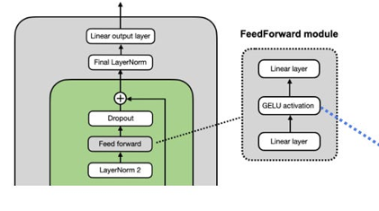

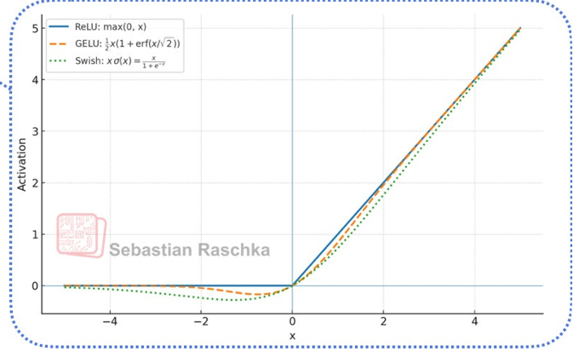
SiLU (Sigmoid Linear Unit) / Swish
A smooth activation that is slightly cheaper than GELU in large decoder MLPs
Mostly an engineering preference rather than a dramatic modeling difference
Typical models : Llama, Qwen, DeepSeek, GPT-OSS, Mistral, Sarvam
Swish is used in most architectures today
https://sebastianraschka.com/llms-from-scratch/ch04/11_silu/

Slide 21
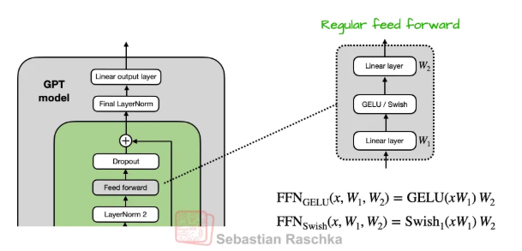
Regular FFNN module (2 layer MLP)
Traditional FFN that follows self-attention layer consists of two linear layers with a non-linear activation function in between
← Using GELU and Swish (ignoring bias terms)
Figure credit : https://magazine.sebastianraschka.com/p/from-gpt-2-to-gpt-oss-analyzing-the
GLU Variants Improve Transformer

Slide 22
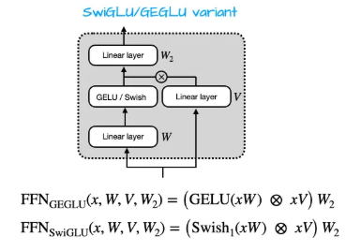
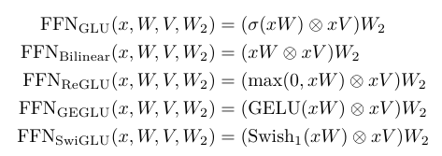

FFNN with Gated Linear Unit (GLU)
Controls information flow using a gating mechanism ($GELU\left(xW\right)$ or $Swish\left(xW\right)$ is the gate-like modulator)
GLUs can suppress noisy or irrelevant features and amplify useful ones on a per-dimension basis.
2 fully connected layers are replaced by 3 fully connected layers
Almost all state-of-the-art models currently have moved away from the standard GELU or ReLU in favor of a gated architecture and adopted of GLU variants
Bilinear Layer : Omitting the activation, which they call a "bilinear" layer
Figure credit : https://magazine.sebastianraschka.com/p/from-gpt-2-to-gpt-oss-analyzing-the
GLU Variants Improve Transformer

Slide 23
Mixture of Experts (MoE)

Slide 24
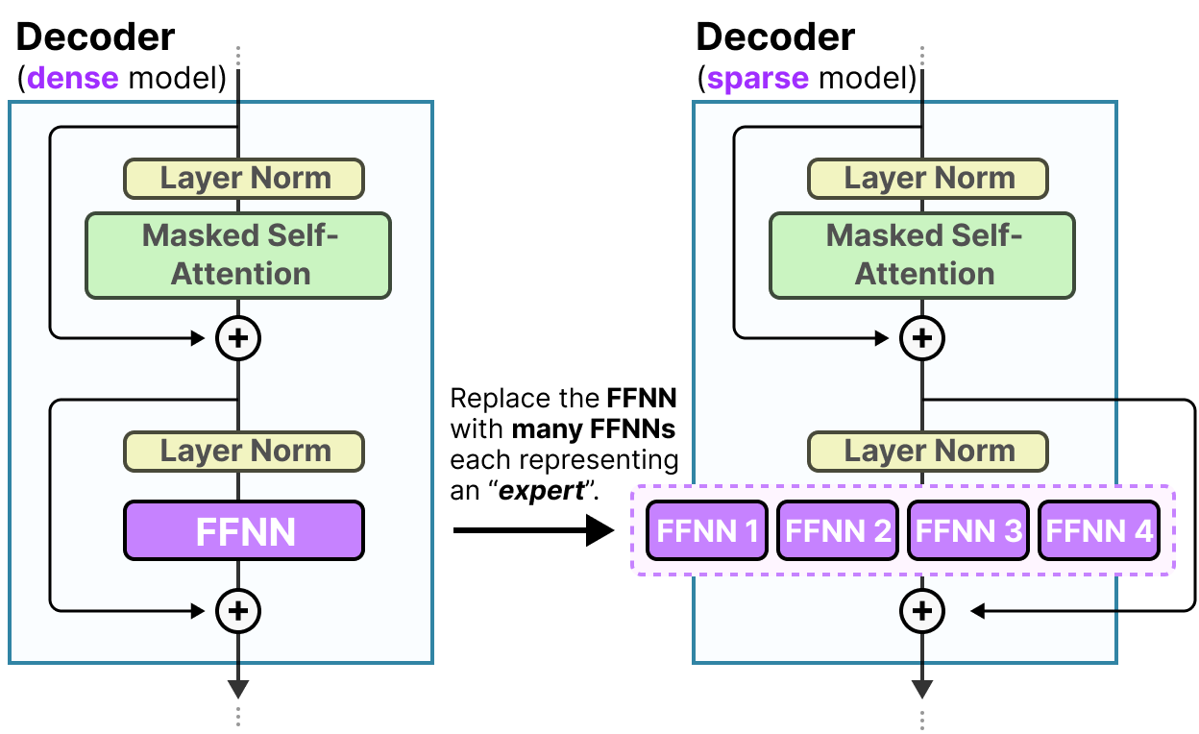
Mixture of Experts (MoE)
Dense Layers : FFNN in a traditional Transformer is called a dense model since all parameters (its weights and biases) are activated
Sparse Layers : sparse models only activate a portion of their total parameters and are closely related to Mixture of Experts
Decoder block now has multiple FFNNs (each an “expert”) that it can use during inference
MoE : A technique that uses many different sub-models (or “experts”) to improve the quality of LLMs
MoE saves FLOPs by activating only a few experts
https://newsletter.maartengrootendorst.com/p/a-visual-guide-to-mixture-of-experts

Slide 25
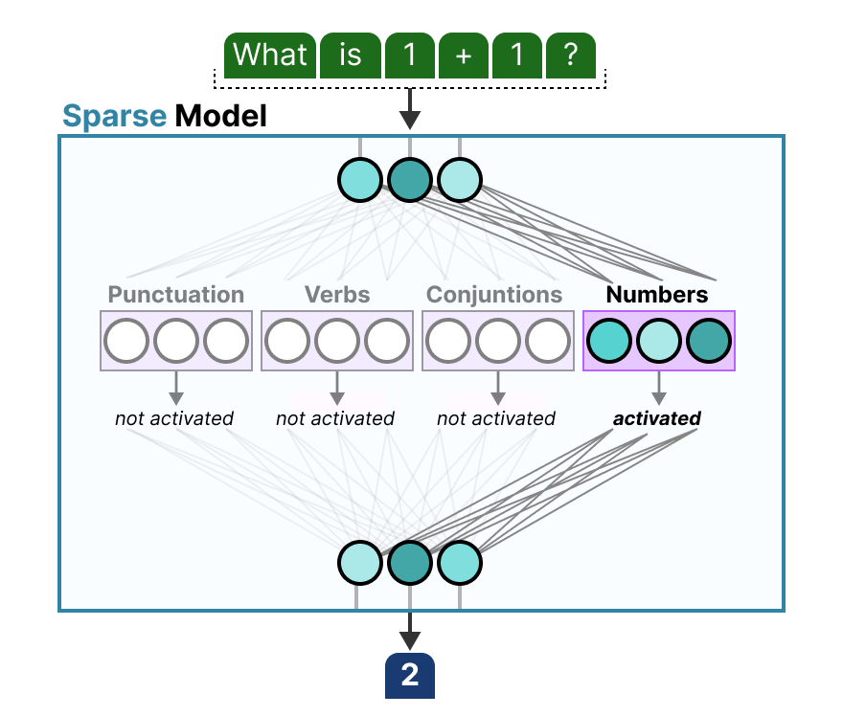
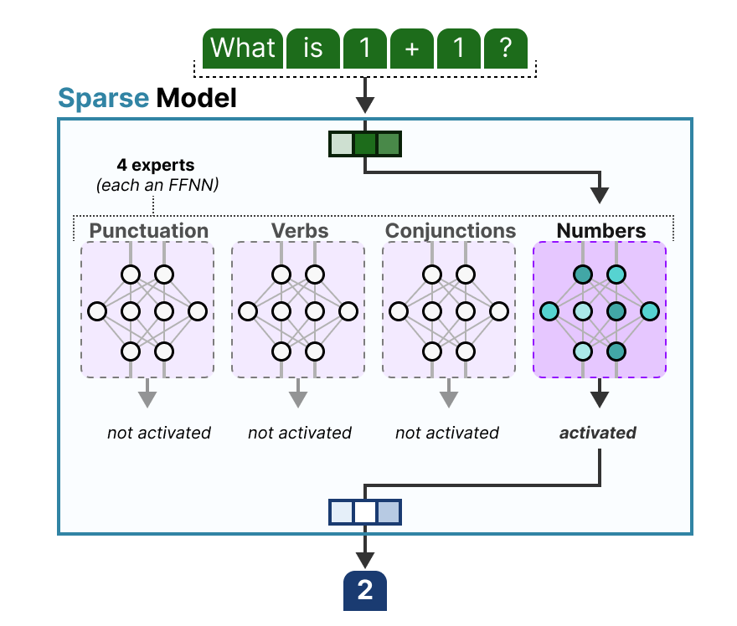
Architecture of Experts
more model capacity at roughly fixed per-token compute
https://newsletter.maartengrootendorst.com/p/a-visual-guide-to-mixture-of-experts

Slide 26
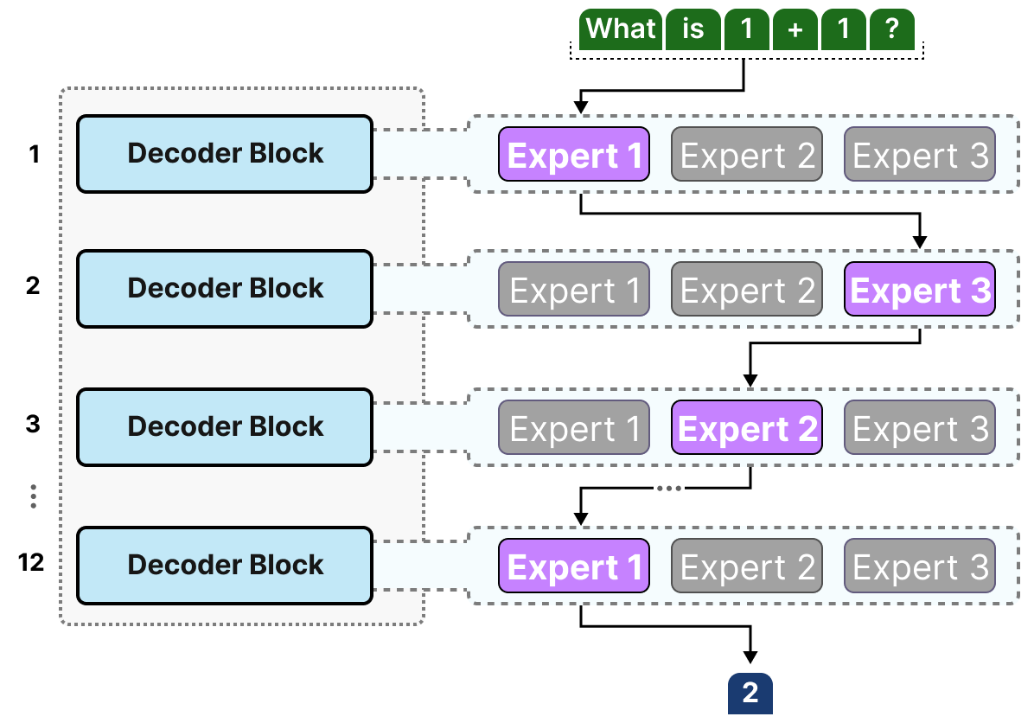
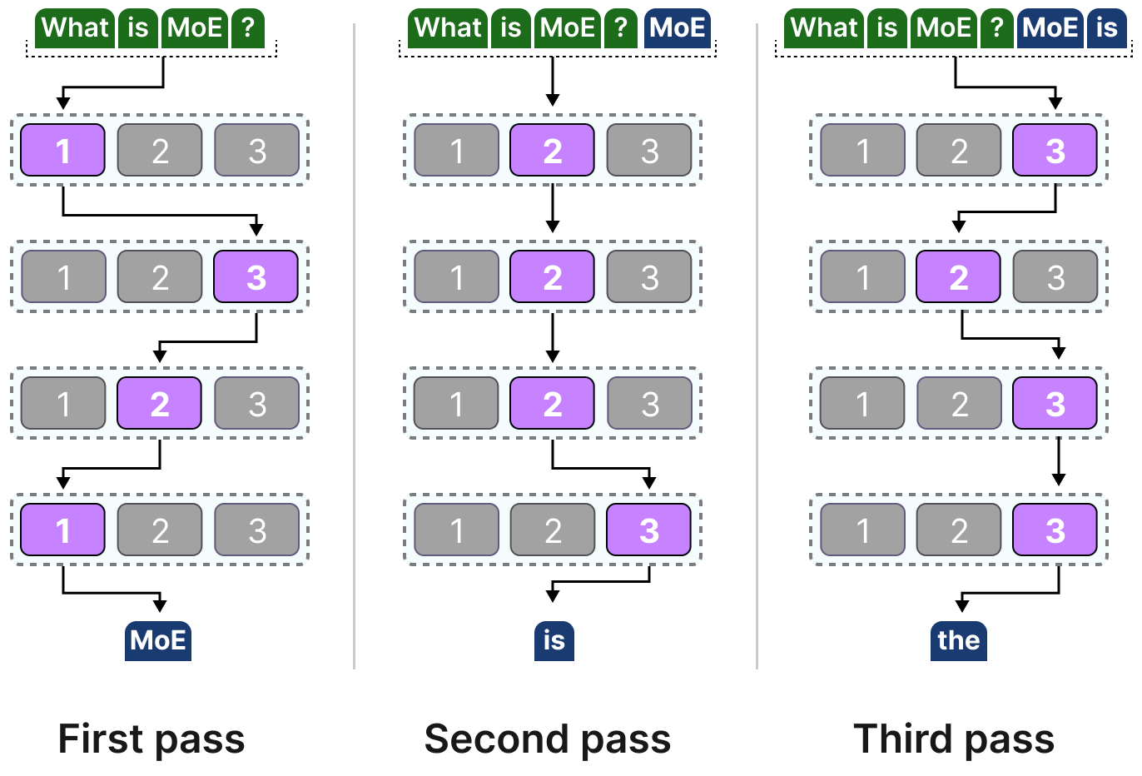
Mixture of Experts (MoE)
Most LLMs have several decoder blocks, a given text will pass through multiple experts before the text is generated
Different “paths” for different tokens
Model can have much higher total capacity while keeping only a smaller active path per token
https://newsletter.maartengrootendorst.com/p/a-visual-guide-to-mixture-of-experts

Slide 27
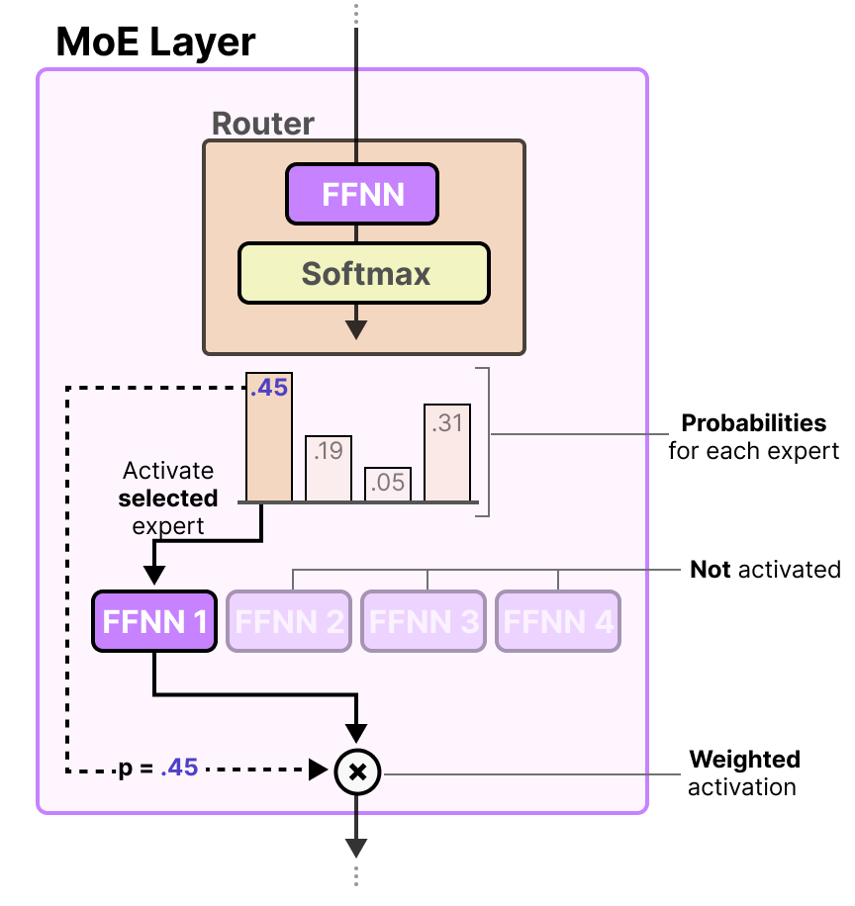
Mixture of Experts (MoE)
Router (or gate network) is also an FFNN and is used to choose the expert based on a particular input
It outputs probabilities which it uses to select the best matching expert
Expert layer returns the output of the selected expert multiplied by the gate value (selection probabilities)
https://newsletter.maartengrootendorst.com/p/a-visual-guide-to-mixture-of-experts

Slide 28
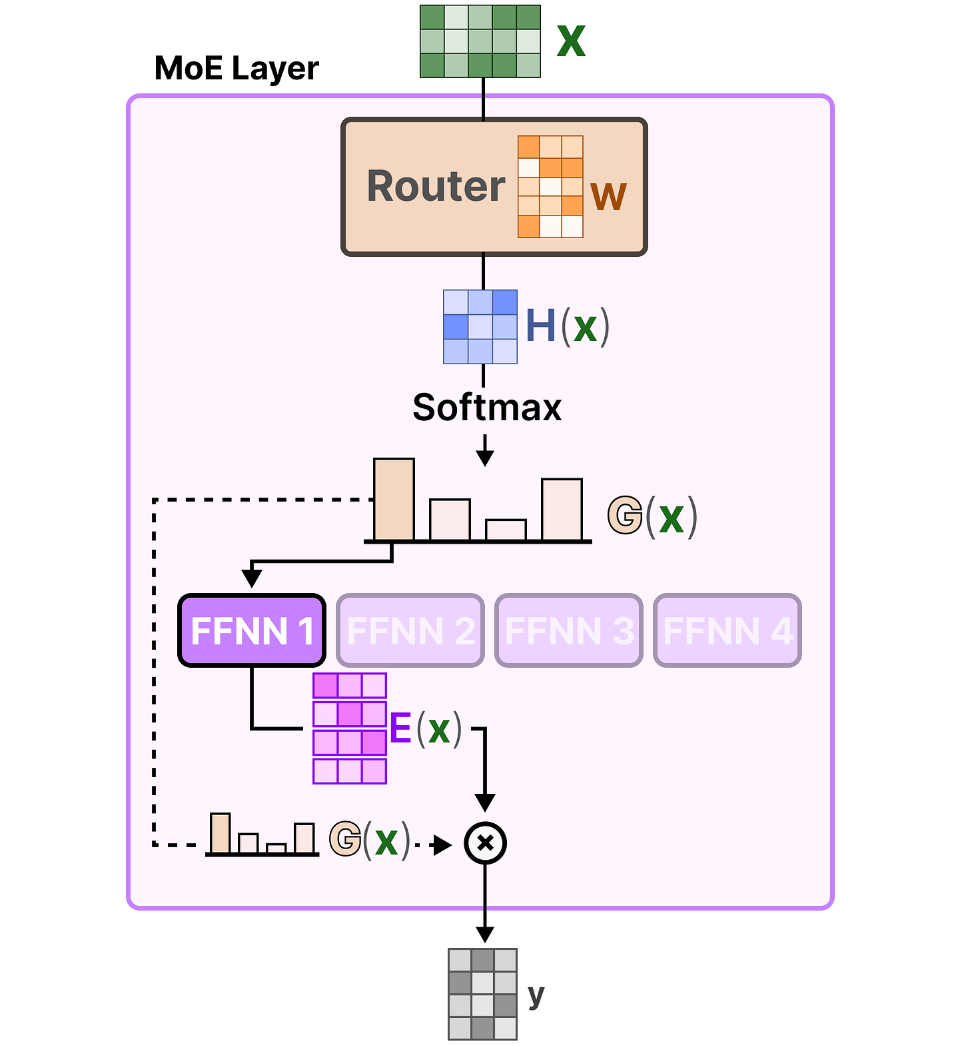
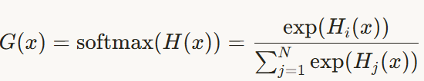

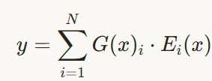
Mixture of Experts (MoE)
input flows through the router and experts
H(x)=W⋅x

Slide 29
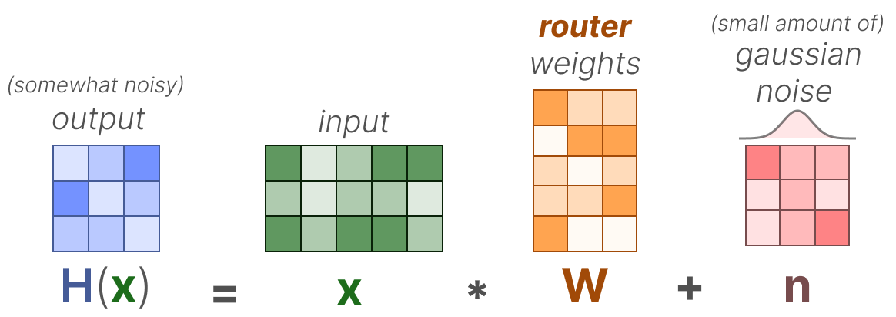
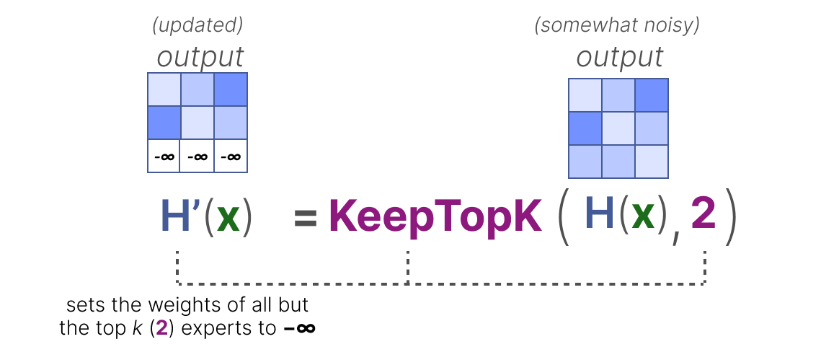
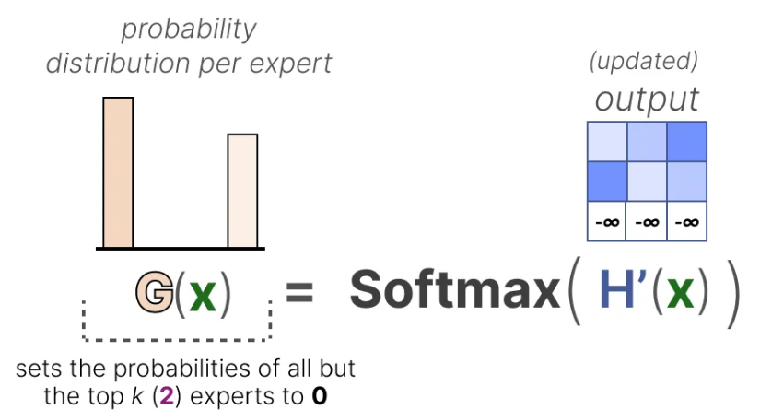
Load Balancing: KeepTopK
By introducing trainable (gaussian) noise, we can prevent the same experts from always being picked
All but the top k experts (for example 2) will have their weights set to -∞:
By setting these weights to -∞, the output of the SoftMax on these weights will result in a probability of 0
KeepTopK can also be used without the additional noise

Slide 30
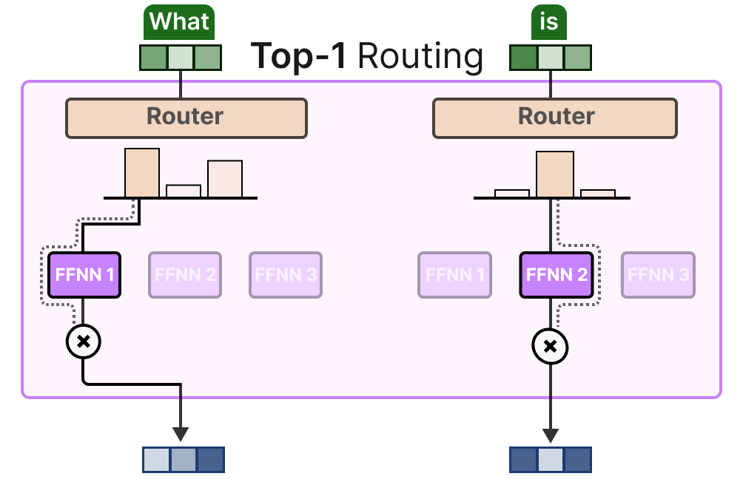
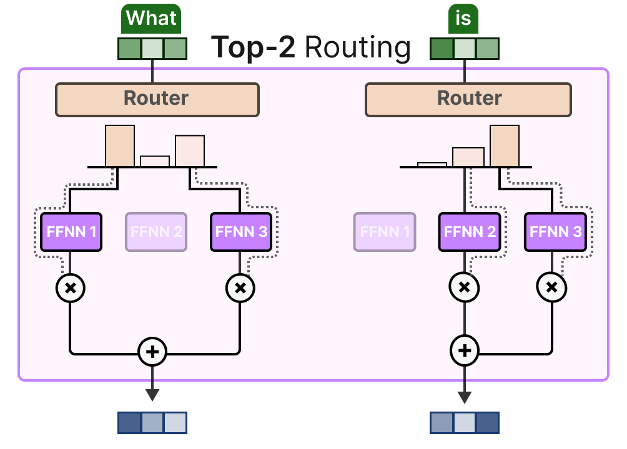
Load Balancing: Token Choice
allows for a given token to be sent to one expert (top-1 routing) or to more than one expert (top-k routing)
Experts’ respective contributions to be weighed and integrated
https://newsletter.maartengrootendorst.com/p/a-visual-guide-to-mixture-of-experts

Slide 31
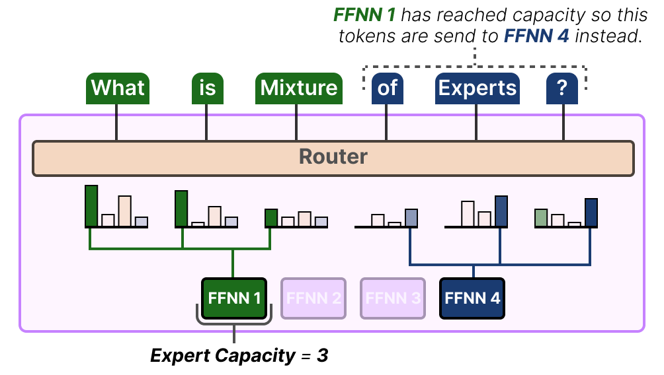
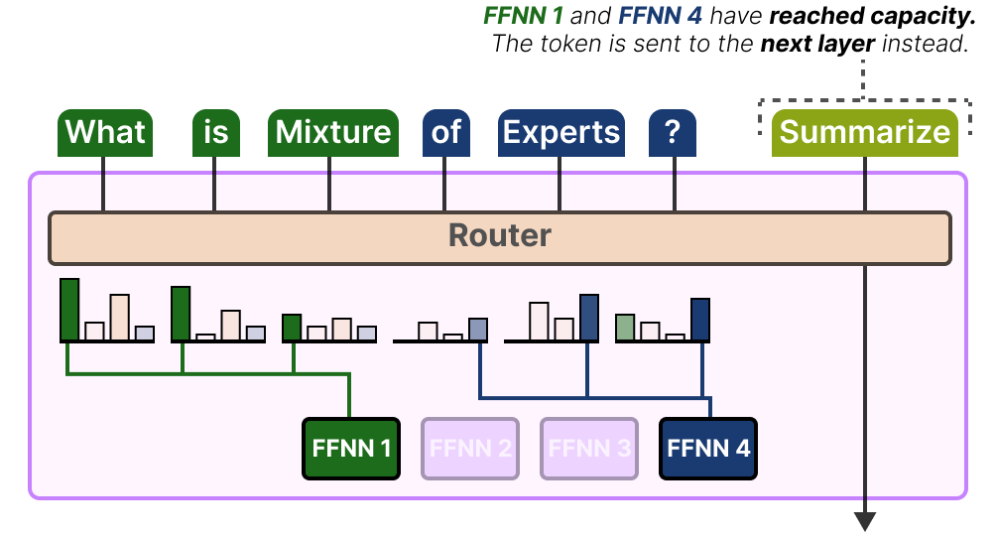
Load Balancing: Expert Capacity
It is not just about which experts are used but how much they are used
A solution to this problem is to limit the amount of tokens a given expert can handle, namely Expert Capacity
By the time an expert has reached capacity, the resulting tokens will be sent to the next expert
Token overflow : If both experts have reached their capacity, the token will not be processed by any expert but instead sent to the next layer
https://newsletter.maartengrootendorst.com/p/a-visual-guide-to-mixture-of-experts

Slide 32
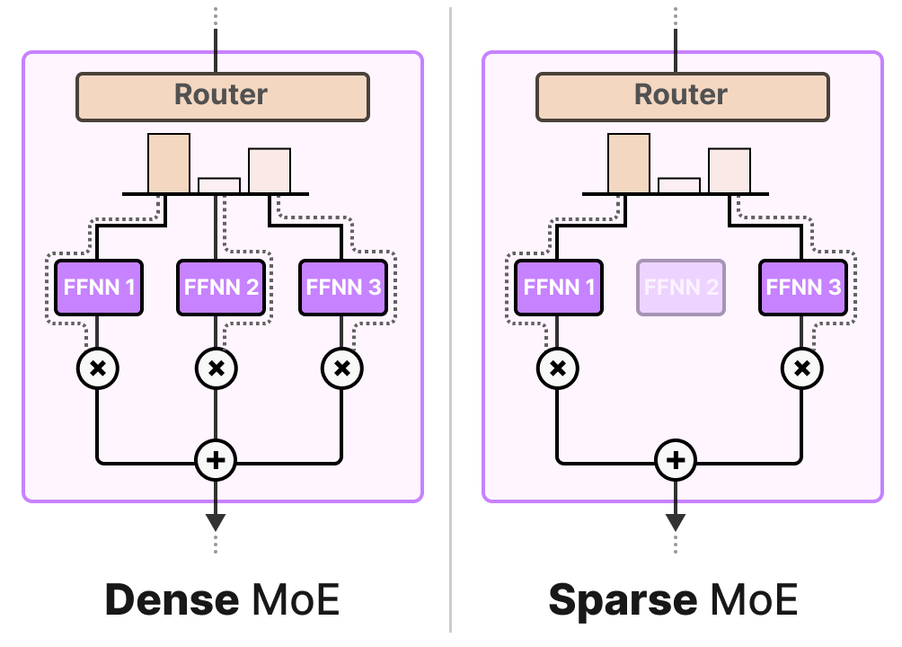
Sparse MoE
Sparse MoE only selects a few whereas a Dense MoE selects them all but potentially in different distributions
Newer models like Qwen3-Next and Llama 4 (Maverick/Scout) use a hybrid architecture that adjusts sparsity based on the task difficulty
Maverick (Llama 4 variant): Uses 128 experts with a 17B active parameter profile
Dynamic Sparsity: These architectures can increase the number of active experts during "Thinking Mode" (Reinforcement Learning-driven reasoning) and decrease them for standard chat, effectively behaving like two different models in one

Slide 33
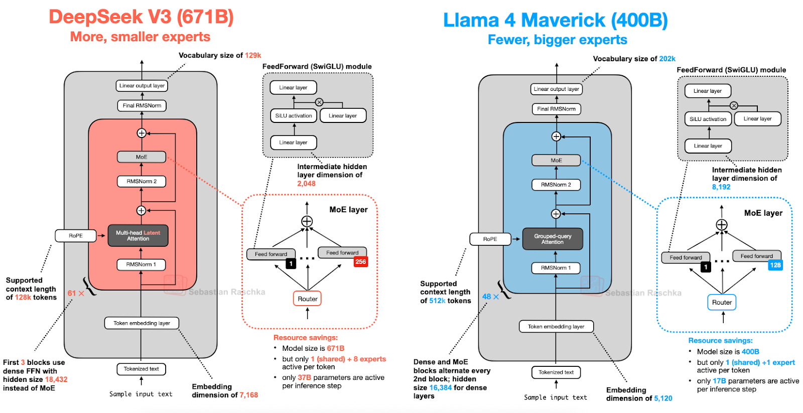

Slide 34
MoE
Benefits
  Scaling efficiency: MoE can increase representational capacity while keeping active parameters per token much smaller than total parameters
  Different experts can become good at different patterns, domains, or token types, and the router learns which ones to use
Issues
  systems and training challenges
    Routing overhead
    Expert load-balancing problems
    Training instability
    More complicated deployment
  It can reduce compute per token, but total model memory is still large, so serving MoE models efficiently remains harder

Slide 35
Sample Questions
Question: You are designing a very deep decoder-only LLM with more than 100 layers and want stable training with lower computation. Which normalization strategy would you choose, and why?
Answer:
  RMSNorm with a Pre-Norm placement
  RMSNorm is a simplified alternative to LayerNorm because it rescales using the root-mean-square of activations and does not compute both mean and variance.
  This makes it cheaper 7–15% faster than LayerNorm due to fewer operations.
  Pre-Norm keeps the residual path outside the normalization and gives gradients a direct highway through the network.
  Because Pre-Norm trains stably even at 100+ layers and tolerates larger learning rates without careful warm-up, this combination is better for scaling deep LLMs.

Slide 36
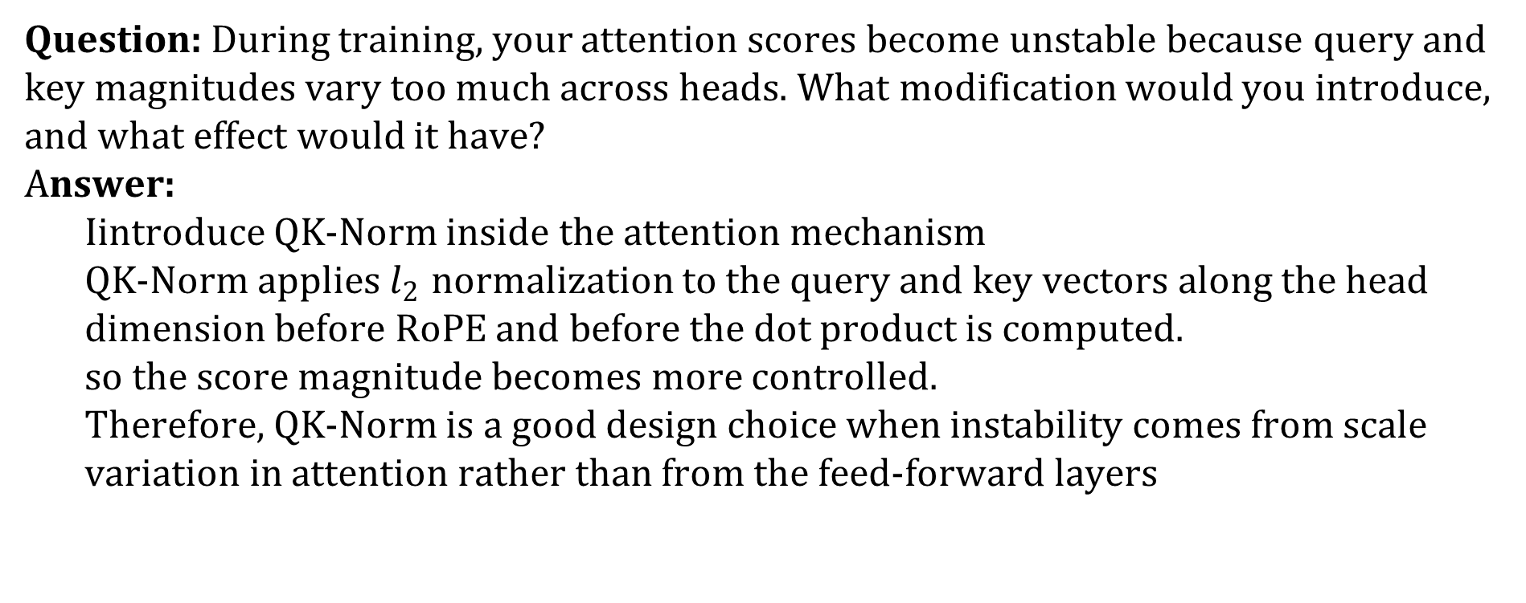
Sample Questions
Question: During training, your attention scores become unstable because query and key magnitudes vary too much across heads. What modification would you introduce, and what effect would it have?
Answer:
  Iintroduce QK-Norm inside the attention mechanism
  QK-Norm applies $l_{2}$ normalization to the query and key vectors along the head dimension before RoPE and before the dot product is computed.
  so the score magnitude becomes more controlled.
  Therefore, QK-Norm is a good design choice when instability comes from scale variation in attention rather than from the feed-forward layers

Slide 37
Sample Questions
Question: In an MoE architecture, explain the concept of "Expert Capacity" and the consequence of "Token Overflow." How do these design choices impact the training and inference of a sparse model?
Answer:
Expert Capacity: To prevent certain "popular" experts from being overwhelmed and to ensure balanced parameter usage, a limit is placed on the number of tokens a single expert can handle.
Token Overflow: If an expert reaches its capacity, any additional tokens assigned to it by the router are either sent to the next available expert or, if all assigned experts are full, sent directly to the next layer without being processed by an expert.
Impact on Training/Inference: Load balancing (using techniques like KeepTopK with noise) ensures that the model utilizes its total capacity rather than always picking the same few experts. While this prevents bottlenecks, token overflow can lead to a slight loss in performance for the specific bypassed tokens, necessitating a balance between capacity and computational efficiency.

Slide 38
References
Hands-On Large Language Models by Jay Alammar and Maarten Grootendorst, Oreilly : Ch- 3
https://sebastianraschka.com/llms-from-scratch/ch04/
https://magazine.sebastianraschka.com/p/the-big-llm-architecture-comparison
https://sebastianraschka.com/llm-architecture-gallery/
https://newsletter.maartengrootendorst.com/p/a-visual-guide-to-mixture-of-experts
https://newsletter.maartengrootendorst.com/p/a-visual-guide-to-mamba-and-state
Vector rotation
  https://www.youtube.com/watch?v=tEUpWgy-Tuo&list=PLYnrabpSIM-93QtJmGnQcJRdiqMBEwZ7_&index=5
https://www.youtube.com/watch?v=qKUobBR5R1A
Research Papers
Self-Attention with Relative Position Representations
GAUSSIAN ERROR LINEAR UNITS (GELUS)
Sigmoid-Weighted Linear Units for Neural Network Function Approximation in Reinforcement Learning
GLU Variants Improve Transformer
ROFORMER: ENHANCED TRANSFORMER WITH ROTARY POSITION EMBEDDING

Slide 39
Revision slides

Slide 40

Absolute Position Embedding
Sinusoidal (Original Transformer)
  Proposed by Vaswani et al. (2017), each position gets a fixed vector using alternating sine and cosine functions across dimensions
  No learned parameters — fully deterministic and fixed
  Limitation: positions beyond training length have never been seen
    pos = position of word in sequence (e.g., 0, 1, 2, ...)
    i = index of dimension within embedding vector (e.g., 0, 1, 2, ... up to d_{model} -1)
    d_{model} = size of embedding vector (e.g., 512)

Slide 41
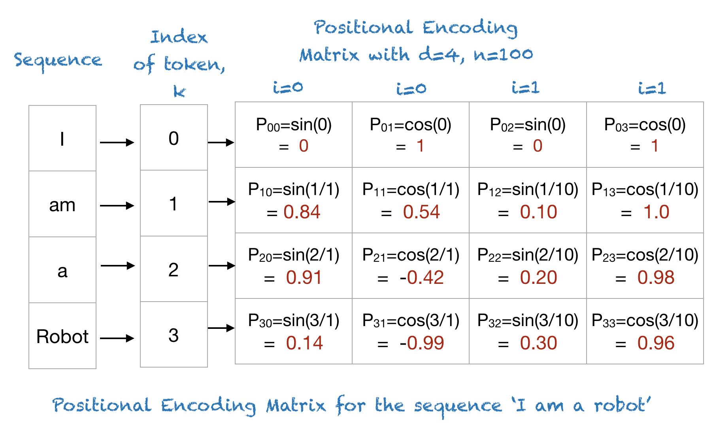
Transformers
Position representation vectors through sinusoids
Each position/index is mapped to a vector
d= Dimension of the output embedding space
i= Used for mapping to column indices 0≤i<d/2, with a single value of i maps to both sine and cosine functions
A combination of sine and cosine functions with differing frequencies was used in the original transformer work.
Image credit: https://machinelearningmastery.com/a-gentle-introduction-to-positional-encoding-in-transformer-models-part-1/

Slide 42
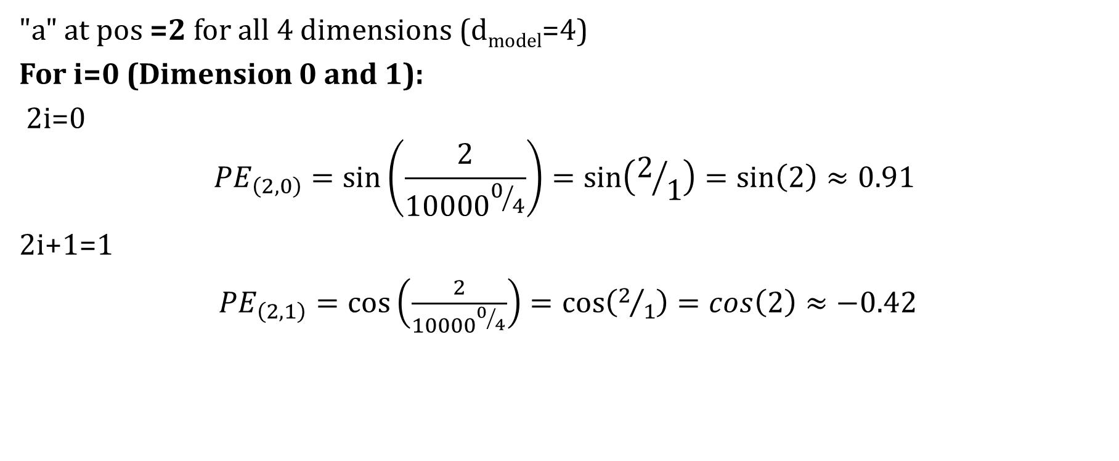
Sample calculation
"a" at pos =2 for all 4 dimensions (d_{model}=4)
For i=0 (Dimension 0 and 1):
2i=0
$${PE}_{\left(2,0\right)}=\sin\left(\frac{2}{{10000}^{0/4}}\right)=\sin\left(2/1\right)=\sin\left(2\right)≈0.91$$
2i+1=1
${PE}_{\left(2,1\right)}=\cos\left(\frac{2}{{10000}^{0/4}}\right)=\cos\left(2/1\right)=\cos\left(2\right)≈−0.42$

